Slide 1


Toronto Airbnb Listings
Market Overview For September 2022 to June 2023

Slide 2
Contents
Project Objective
Approach
Analysis
Findings

Slide 3
Project Objective
The goal of this project is to get an overview of the Airbnb
market in Toronto, Ontario
The time period will be from September 2022 to June 2023
Discover how prices have changed over time
Find out which room types and neighbourhoods have the
most listings and how this changed over the period
See if there are any trends that emerge from the analysis

Slide 4
Approach
Data was taken from Inside Airbnb
Data was cleaned and prepared using Python. Analysis and
visualizations were also done in Python
Some of the data cleaning involved removing listings with minimum
night requirements over 33 days, removing listings with 0
availability throughout 365 days in the future, and removing
outliers
Tableau Dashboard was created with cleaned data:
(Toronto Airbnb Listings Dashboard)

Slide 5
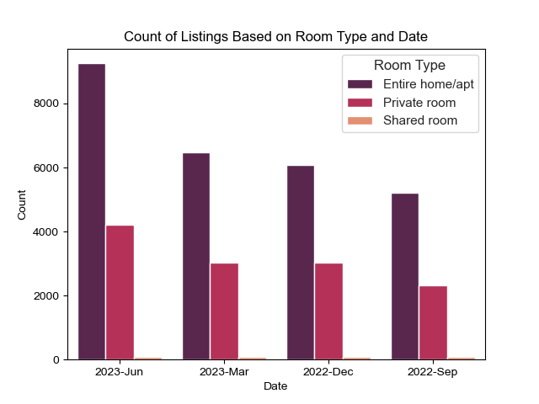
Analysis
Room Type
Count plot shows ‘Entire home/apt’ had the most growth throughout period, followed by ‘Private room’. ‘Shared room’ had the least amount of listings
‘Entire home/apt’ is the most popular listing

Slide 6
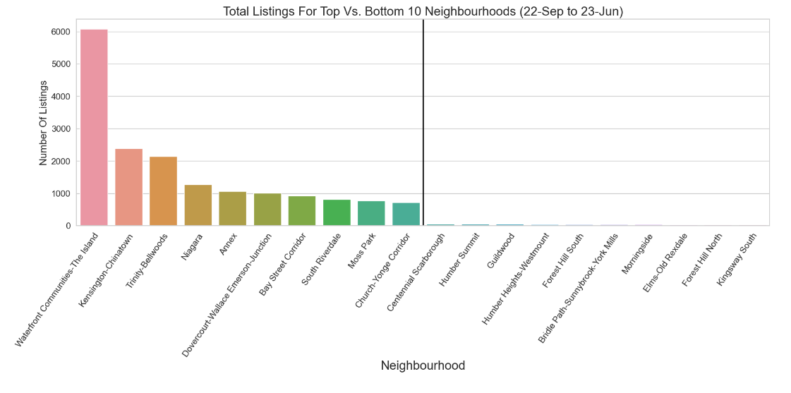
Listings Based On Neighbourhood
Waterfront Communities-The Island is the most popular neighbourhood for Airbnb listings

Slide 7
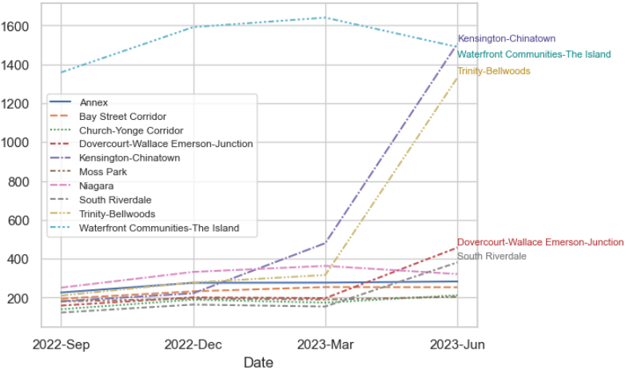
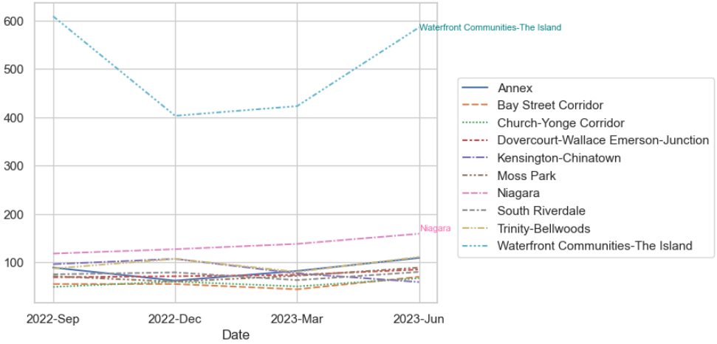
Count of Listings
Top 10 Neighbourhoods
Top 10 Neighbourhoods
Short-term rentals ONLY
Significant difference in neighbourhood listing counts when plotting only short-term rentals (less than 28 days)
Kensington-Chinatown and Trinity-Bellwoods have negligible changes in number of listings for June when looking only at short-term rentals

Slide 8
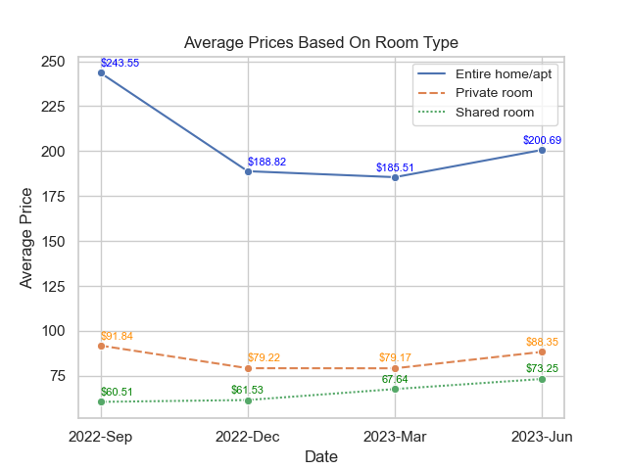
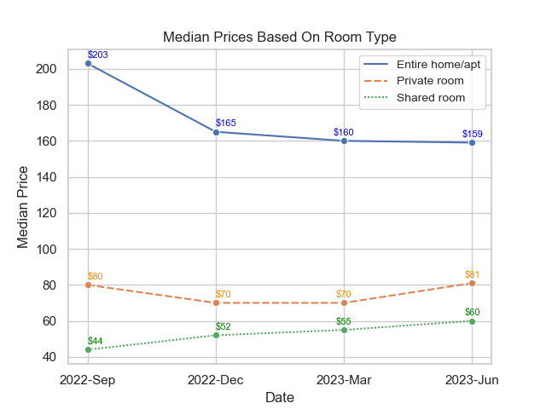
Average & Median Prices Over Period
Average prices for ‘Entire home/apt’ & ‘Private room’ decreased until March 2023 before increasing in June 2023
Median prices show the same pattern, except for ‘Entire home/apt’, most likely due to increased number of listings at higher prices

Slide 9
Findings
Majority of listings in Toronto are for long-term rentals (28 days or longer). 70.33% of listings in June were for long-term rentals, while only 29.67% were for short-term. The trend is that long-term rentals seem to be driving the Airbnb market right now, with short-term rentals staying somewhat stagnant across the city
Growth came from long-term rental listings. This can be seen especially in the Kensington-Chinatown and Trinity-Bellwoods neighbourhoods, where long-term rental growth was significant but short-term rental growth was almost non-existent
Waterfront Communities-The Island is the most popular neighbourhood for Airbnb listings, making up 15.23% of dataset. It was also the only neighbourhood with considerable growth in short-term listings from March to June 2023
The most popular room type listed is ‘Entire home/apt’, with 67.72% of the listings in the dataset listed as this type. 31.49% are for ‘Private room’ and 0.79% for ‘Shared room’
Average prices had decreased from September 2022 to March 2023, before moving up in June 2023. Prices in general seem to be trending upwards, but will have to be confirmed with future data

